Slide 1
Credit one Reducing customer defaults Strategic overview
Author: Jason Rodriguez

Slide 2
Agenda
Business Problem
Business Goals / Objectives
Process Framework
Data Sources & Management
Potential Challenges
Process Flow
Initial Insights

Slide 3

Business Problem(s)
Problem 1
Inadequate methodology & procedures for accurately identifying customers who may pose a risk to loan defaults.
Problem 2
No repeatable solution to predict the risk of likelihood of customer defaulting on loans & how much credit to approve them for.
Failure to resolve the increase in loans defaults will pose a serious risk to a lost of business.

Slide 4




Business Objectives
OBJECTIVES
Insights
Identification
Predictive Model
Recommendations
Explore existing dataset and analyze information to identify correlations and other business insights.
Identify strongest indicators that predict whether customer may default or not.
Build a model that helps determine how much credit to allow a customer in order to minimize the risk of default.
Clearly communicate results and recommendations to senior leadership.
Project Goal(s):
Understand the customer features that may lead to defaulting on credit.
Determine if Credit One can predict credit limits with 80% or higher level of certainty of not defaulting

Slide 5
R Framework for Analysis
Define Goal(s)
What are we solving?
What limitations/constraints exist?
SMART goals
What solutions is being requested?
1. Define Goal(s)
2. Collect / Manage Data
Data Acquisition
Data Processing/Cleansing
Data Exploration
6. Deployment of Model
2. Collect / Manage Data
3. Build Model
Model Definition
Model Development
4. Evaluate / Critique Model
Model Examination
Stage gate decision
Data Science Framework
5. Present Results
Stakeholder analysis & communication needs
Packaging deliverables
Report creations
Communication execution
5. Present Results
3. Build Model
6. Deploy Model
Deployment strategy & requirements
User guides / model documentation
Transition
Leveraging the “Practical Data Science w/ R” Framework (Zumel & Mount)
4. Evaluate / Critique Model

Slide 6
1. Define Goals
1. Define Goal(s)
6. Deployment of Model
2. Collect / Manage Data
What are we solving?
Addressing Credit One challenges around the increase in customer loan defaults which could potentially have negative impacts on the business.
What limitations/constraints exist?
Potential challenges could be lack of clear definitions from business requirements and goals.
SMART goals
Target a model that can predict 80% or higher level of certainty of not defaulting
Data Science Framework
5. Present Results
3. Build Model
4. Evaluate / Critique Model

Slide 7
2. Collect / Manage Data
1. Define Goal(s)
Data: customer provided raw credit card data for analysis.
30K observations
25 features
ID
Limit_Bal
Sex
Education
Marriage
Pay_0 – Pay6 → history of past payments (e.g., no consumption, pay delays, etc…)
Bill_Amt 1- Bill_Amt6 → bill statement amount
Pay_Amt1 – Pay_Amt6 → amount of previous payments
Default Status
Data Management:
Version control of all changes will be kept for both retention purposes and backup
The original source file will not be modified but alter version of any cleansing and new features will be established in new version for modeling purposes.
6. Deployment of Model
2. Collect / Manage Data
Data Science Framework
5. Present Results
3. Build Model
4. Evaluate / Critique Model

Slide 8
3. Build Model
1. Define Goal(s)
Model: the goal is to target the definition and creation of 3 models to identify the best performing model for continued use into the future and implementation of Credit One’s credit limit evaluation for future customers.
Target Goals for Model:
Must achieve 80% or higher on accuracy
Must meet stakeholder requirements & needs
6. Deployment of Model
2. Collect / Manage Data
Data Science Framework
5. Present Results
3. Build Model
4. Evaluate / Critique Model

Slide 9
4. Evaluation
1. Define Goal(s)
6. Deployment of Model
2. Collect / Manage Data
Model Examination: evaluate the models against various performance factors to determine feasibility of the model. As part of this evaluation; enhancements will be identified to further tune and optimize model performance. This process is iterative in nature and will be conducted to identify the best in class model for our goals.
Stage Gate: implement a stage gate evaluation steps to individually assess each model to determine alignment and success factors of addressing the goals.
Data Science Framework
5. Present Results
3. Build Model
4. Evaluate / Critique Model

Slide 10
5. Presentation of Results
1. Define Goal(s)
6. Deployment of Model
2. Collect / Manage Data
Stakeholder Analysis: identify all key stakeholders to identify the appropriate level of information needed and style of communication to produce. For example, when presenting to technical community we may leverage more codes review and white papers whereas when presenting to executive leadership summarize findings and business challenges will be delivered.
Communication: present key findings and model results to key stakeholders by 30-May-2020.
Data Science Framework
5. Present Results
3. Build Model
4. Evaluate / Critique Model

Slide 11
6. Deployment of Model
1. Define Goal(s)
6. Deployment of Model
2. Collect / Manage Data
Deployment Strategy: identify the technical requirements & target environment for post go-live deployment.
Transition Strategy: identify the level of training required, technical manuals, and end-user guides needed to fully educate end-users; as well as, having fully transparency into the use of the model
Go-Live Deployment: work with other technical teams to develop a robust deployment schedule/checklist to ensure smooth code drop and defect resolutions.
Data Science Framework
5. Present Results
3. Build Model
4. Evaluate / Critique Model

Slide 12
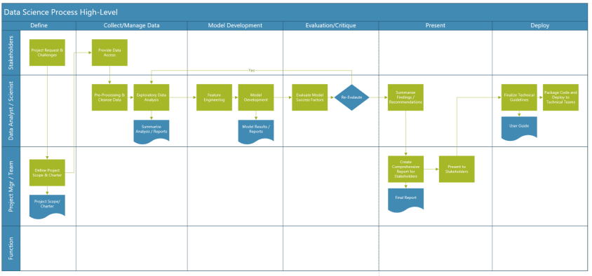
Modeling Process Flow
Note: the high-level process flow illustrates the conceptual workflow steps to be taken to execute the data science effort.

Slide 13
Initial Insights & Observations
Potential Data Issues
Column headers to be corrected for:
“PAY_O”; does not follow consistent standard of other columns → correction to relabel as “Pay_1”
“default payment next month”; not best practice → correction to relabel as “default_status”
Categorical values for “default_status”, “sex”, and “education” → will change to numerical values for modeling purposes

